Slide 1
Recursion Series
_{Lecture 1}

Slide 2
What is Recursion?
A very powerful problem solving technique
https://www.google.com/search?sca_esv=581969934&sxsrf=AM9HkKk7KTIuKksMm8e8qUJbOFq2VLhfrA:1699896914674&q=recursion&spell=1&sa=X&ved=2ahUKEwj5z4O-wcGCAxVewjgGHTYcBcQQBSgAegQICRAB&biw=1242&bih=592&dpr=1.1 try out this link, see if you can find a “bug” . :p
In computer science recursion means repetitive occurrence of a function within itself. def xyz( ):
xyz( )
It is loop right!!!!

Slide 3
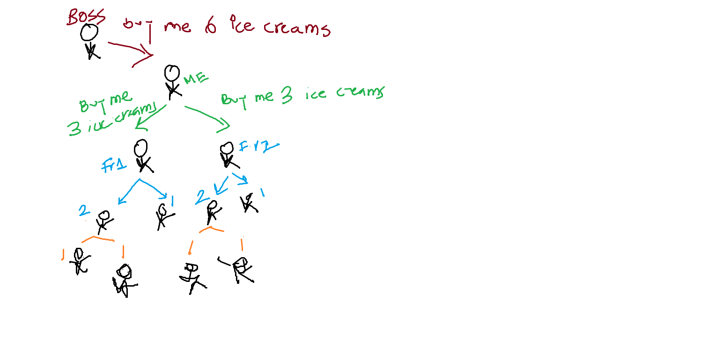
Core purpose of Recursion
Although a for/while loop can be replaced with recursion
The main purpose is to solve problems, containing some n number of steps and at each step we need to do the same task

Slide 4
The Big Picture
Problem statement (task): buy ice creams
Initial problem size: 6
Recursive task: buy ice creams
Problem size is getting smaller at each step
Stop recursion when reach base case
Solve the task at the base and move up

Slide 5
Applications
Recursion is used in Graphs and Trees
Base of Divide and Conquer
End of the first lecture of the Recursion series.

Slide 6
Recursion Series
_{Lecture 2}

Slide 7

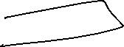

Recap
Recursion is process of solving a problem repeating some task
The original problem is broken down into smaller pieces in n steps until it reaches base case
At the base case do the real work and pass the solution to its previous step

Slide 9
Recalling Functions
Functions
void (non return type)
Return type

Slide 10
Return vs Void
def m():
print("hello")
return
def k():
return 1
‘void’ is also a return type function that does not return any value [do not confuse with null/None]
Don’t need to use the return key word [writing return at the end does not hurt]
Return type function must return a value [something that can be used can be null/None]
Must use the return key word

Slide 11
More on Return
3 functions
func2 is called inside func1
func3 is called inside func2
Follow the blue arrow
func1 ( ):
print(“first”)
func2( )
print (last)
func2 ( ):
print(“second”)
x = func3( )
print (ret)
print (second last)
After func3 ends, the execution pointer moves to where func3 was called carrying the return value
Same thing happens for func2 but as the return key word is not mentioned, no value is carried while returning to where it was called.
func3 ( ):
print(“last”)
return “ret”

Slide 12
? How does the program pointer know exactly where to return?
K
C
A
T
S

Slide 13
Recursion Series
_{Lecture 3}

Slide 14

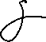



Recap of Lecture 2
The return keyword
In functions where we need to return a physical value we explicitly use the word return followed by the value/variable at the end of the function
In function where we do not need to return a physical value we do not need to write return at the end because developers have done it for us which remains invisible. But we can over write the invisible return by typing return followed by no value.
def m():
print("hello")
return
def k():
return 1

Slide 15
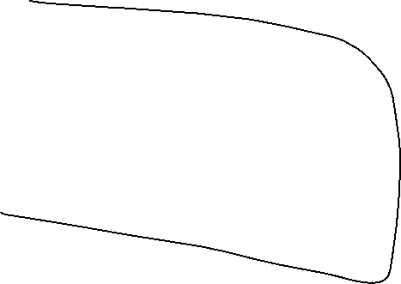






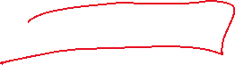

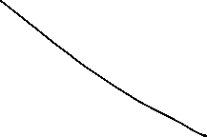





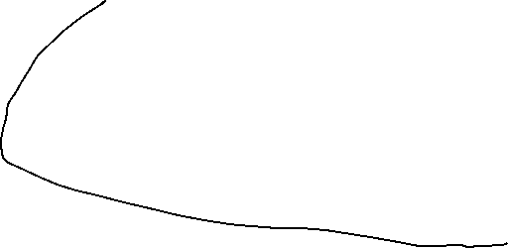

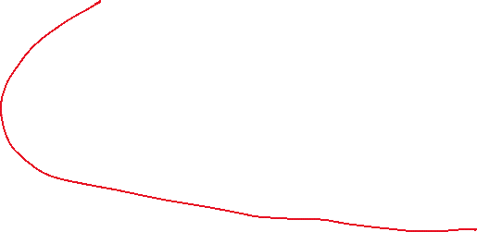



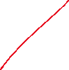
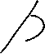

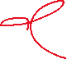
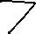







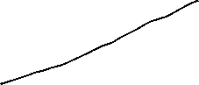



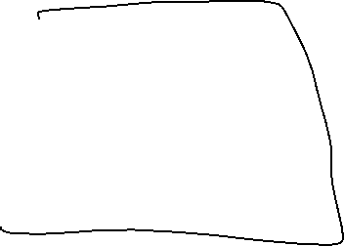




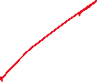

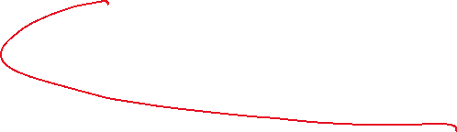
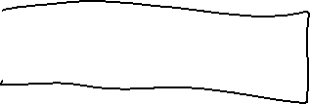
Meaning of return keyword
func1 ( ):
print(“first”)
func2( )
print (“last”)
func2 ( ):
print(“second”)
x = func3( )
print (x)
print (“second last”)
func3 ( ):
print(“last”)
return “ret”
1. Return the value to the source
2. Return the execution pointer to the source

Slide 16

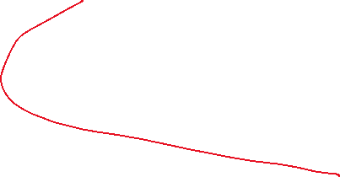


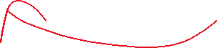
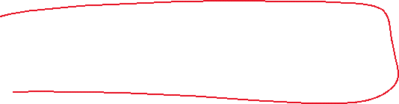

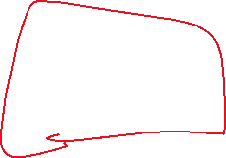


Where exactly to return??
func1 ( ):
print(“first”)
func2( )
print (last)
func2 ( ):
print(“second”)
x = func3( )
print (ret)
print (second last)
func3 ( ):
print(“last”)
return “ret”

Slide 17






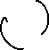
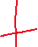

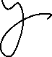

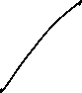
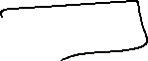

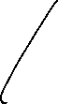
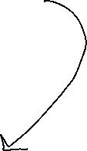
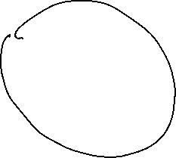




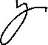
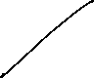
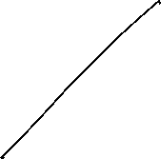


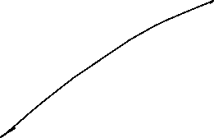



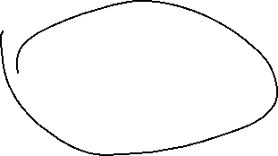

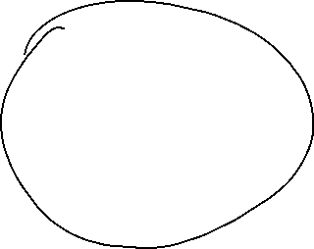

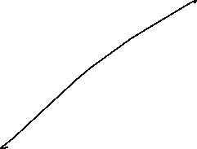


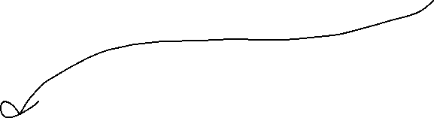
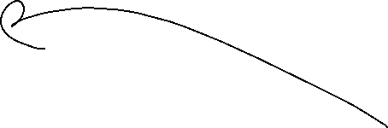
func2 ( ):
print(“second”)
x = func3( )
print (ret)
print (second last)
func1 ( ):
print(“first”)
func2( )
print (last)
func3 ( ):
print(“last”)
return “ret”

Slide 18
func3 ( ):
print(“last”)
return “ret”
func2 ( ):
print(“second”)
x = func3( )
print (ret)
print (second last)
func1 ( ):
print(“first”)
func2( )
print (last)

Slide 19
Stack
Every function call is a push ( current function) – pushing the state of the function into the stack. State includes the values of the local variables and the all the entire function
Every return (End of function) is pop( ) – When a function is popped, according to LIFO the following function becomes the top. Hence the sequence of function call is maintained.

Slide 20




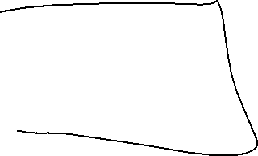
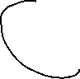
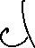



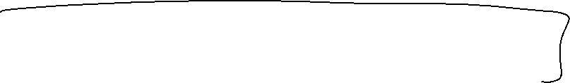


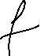

Recursion
Meaning of Recursion is Recursion. [calling myself within myself: in other words loop]
def myself( ):
myself( )

Slide 21
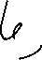


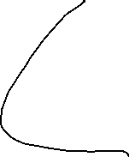
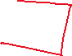
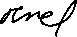



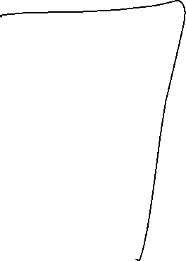
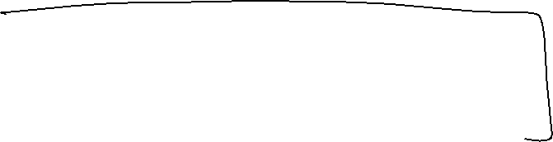



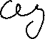


















while( 10):
klklk
lklklk
increment/decrement
def xyz( )
if (<=10):
klklkl
klklklk
xyz( )
else:
Driver class:
xyz()
Recursive call so that it works like a loop
When to stop ??? Logical answer
How do you put the condition inside the function ?

Slide 22
























Solve the first problem
Search for a number in an array(Although using recursion for this problem is an extreme over head but perfect for a start)
Remember recursion is “no loops” but a repetitive function call.
Aspects of Recursion
Break the problem in sub problems
Call the same function on the sub problem(s) not reaching the smallest unit
No function call on the smallest unit [ the actual work of the function call is just to break the problem into pieces]
Do the real work on the smallest unit
If the problem is a return type problem then return the value otherwise do nothing [the invisible return will do its work popping up the stack]

Slide 23























10 | 8 | 23 | -2 | 2
? Identify the task (function) : Search [need to search for a particular element at every step until I find it or reach then end of the array.
? Sub problems: How would you break the original problem into pieces?
Trick: start by trying 1, n-1. Do the actual work on the single unit and apply recursion on the n-1.
As we advance we will come across (n/2, n/2), (n/3,n/3,n/3)
10
8 | 23 | -2 | 2

Slide 24





Understanding recursion for beginner
Write the iterative solution
Convert it to recursion
** This is something
you must NOT rely on **
def search (A, i, key):
while(i<len(A)):
if (A[i] == key):
return True
i=i+1
return False
Base case check
Actual work
Moving to the next step, problem size decreasing
Loop Back (recursion)

Slide 25











def search (A, i, key):
if(i<len(A)):
if (A[i] == key):
return True
i=i+1
search(A, i, key)
return False
def search (A, i, key):
while(i<len(A)):
if (A[i] == key):
return True
i=i+1
return False
Aspects of Recursion
Break the problem in sub problems
Call the same function on the sub problem(s) not reaching the smallest unit
No function call on the smallest unit [ the actual work of the function call is just to break the problem into pieces]
If the problem is a return type problem then return the value otherwise do nothing [the invisible return will do its work popping up the stack]

Slide 26





















































Slide 27






























Slide 28
































































Slide 29
Recursion Series
_{Lecture 4}

Slide 30


Recap
def myself( ):
myself( )
Aspects of Recursion
c = 0
while(c < 10):
klklk
lklklk
increment/decrement
def xyz(c = 0 )
if (c<=10):
klklkl
klklklk
xyz(c+1 )
else:
def search (A, i, key):
if(i<len(A)):
if (A[i] == key):
return True
i=i+1
search(A, i, key)
return False

Slide 31


Important Questions to Ask
Aspects of Recursion
Break the problem in sub problems – How?
Call the same function on the sub problem(s) not reaching the smallest unit – Why?
No function call on the smallest unit [ the actual work of the function call is just to break the problem into pieces] – Why?
If the problem is a return type problem then return the value otherwise do nothing [the invisible return will do its work popping up the stack] – How does it work, will be explained in the following lecture.

Slide 32

Understanding the Aspects
Break the problem in sub problems – How?

Slide 33






Understanding the Aspects
Call the same function on the sub problem(s) not reaching the smallest unit – Why?
Answer: So that it can be broken down further

Slide 34
Understanding the Aspects
No function call on the smallest unit [ the actual work of the function call is just to break the problem into pieces] – Why?
Answer: The smallest unit is the smallest, hence cannot be broken down. The actual work is done on the smallest unit, whether it be matching, comparing, printing or simply just returning [we will examples later]

Slide 35
Understanding the Aspects
If the problem is a return type problem then return the value otherwise do nothing [the invisible return will do its work popping up the stack] – How does it work?

Slide 36
Recursion Series
_{Lecture 5}

Slide 37
Understanding the Aspects
If the problem is a return type problem then return the value otherwise do nothing [the invisible return will do its work popping up the stack] – How does it work?
Answer to this question will be revealed as we go along solving a few problems.

Slide 38
Solving Problems using Recursion
Approach I – Solve the problem iteratively (using loop) then convert it to recursion.
Works for simple problems
Excellent for beginners
Not an ideal approach – will be difficult to comprehend for advanced problems

Slide 39
Solving Problems with Approach I
-- Problems with void return and single loop
Print numbers 1 to n
Search from an array, linked list
Find max, min from an array

Slide 40
Print Numbers 1 - n

Slide 41
Search from an Array, Linked List

Slide 42
Find Max, Min from an Array/Linked List

Slide 43
Underlying Scenario - Stack

Slide 44
Solving Problems with Approach I
-- Problems with value return and single loop
-- How to figure out which problems void and which ones are return types?
void – not dependent on any values from the next step
Return type – dependent on value(s) from the next step
Summation of numbers 1 – n
Factorial
Find max, min from an array

Slide 45

















Slide 46


















Summation of numbers 1 – n

Slide 47


























Slide 48











































Slide 49










Slide 50























Factorial

Slide 51
Find Min/Max

Slide 52














Drawback of Solving with Approach I
Given a family tree, find out the person named RK.
If you start from the top, how would you run the loop?
for each child x of A
if x is RK
return True
else
for each child y of x ……. ???

Slide 53



Solving Problem with Correct Approach
Observe the scenario
Build/ Figure out the logic for the first step
That is the solution
def find(x, “RK”):
if x points to a person:
if x == “RK”
return True
find(left of x)
find(right of x)
return False

Slide 54























Problem Solving – Going Reverse
Remember traversing a singly linked list reverse using loop?
Recursion makes it easy
Stack makes a sequence reverse – push all elements and then pop them
def printReverse(head):

Slide 55
























































Slide 56
















Problem Solving – Going Reverse
Convert a decimal number to binary
Divide the number by 2, store the quotient
Do a mod operation by 2, store the remainder
Recursive call on the remainder, until the number is 1
Reverse print the quotient of every step

Slide 57





















Slide 58





















Problem Solving – Nested Loop
In order to traverse a 2D array, we need a loop for the rows and one for the columns
Hence we need 2 functions – one for each loop
for i = 1 to row
for j = 1 to column
print(A[i][j])

Slide 59
Problem Solving – Lab Question

